Slide 1


<SEETHAGARI HARSHAVARDHAN REDDY>
<23-08-2024>

Slide 2

Outline
Executive Summary
Introduction
Methodology
Results
Conclusion
Appendix

Slide 3
Executive Summary
Summary of methodologies
The research aims to identify key factors contributing to a successful rocket landing. The following methodologies were employed to achieve this:
Data was collected using the SpaceX REST API and web scraping techniques.
Data was wrangled to create a variable indicating success or failure outcomes.
Data exploration was conducted using visualization techniques, focusing on factors such as payload, launch site, flight number, and yearly trends.
The data was analyzed using SQL to calculate statistics, including total payload, payload range for successful launches, and the total number of successful and failed outcomes.
Launch site success rates and their proximity to geographical markers were examined.
Visualization was used to highlight the most successful launch sites and successful payload ranges.
Models were built to predict landing outcomes using logistic regression, support vector machine (SVM), decision tree, and K-nearest neighbor (KNN) algorithms.
Exploratory Data Analysis:
Launch success has improved over time.
KSC LC-39A is the most successful landing site.
Orbits such as ES-L1, GEO, HEO, and SSO have a 100% success rate.

Slide 4
Executive Summary
Results
Exploratory Data Analysis:
Launch success has improved over time.
KSC LC-39A is the most successful landing site.
Orbits such as ES-L1, GEO, HEO, and SSO have a 100% success rate
Visualization/Analytics: Most launch sites are located near the equator and close to the coast.
Predictive Analytics: All models performed similarly on the test set, with the decision tree model slightly outperforming the others

Slide 5
Introduction
Background
SpaceX, a pioneer in the space industry, is committed to making space travel accessible to everyone. The company has achieved significant milestones, including sending spacecraft to the International Space Station, launching a satellite constellation for global internet access, and conducting manned space missions. SpaceX's ability to offer relatively inexpensive rocket launches ($62 million per launch) is largely due to its innovative approach of reusing the first stage of its Falcon 9 rocket. In contrast, other providers, who cannot reuse the first stage, have launch costs exceeding $165 million per mission. By predicting whether the first stage will successfully land, we can estimate the cost of the launch. Public data and machine learning models can be employed to predict the likelihood of SpaceX—or a competitor—reusing the first stage.
Explore:
How factors like payload mass, launch site, number of flights, and orbits influence first-stage landing success.
The trend of successful landings over time.
The most effective predictive model for determining successful landings (binary classification).

Slide 6

Section 1

Slide 7
Methodology
Request Data: Retrieve rocket launch data by making a request to the SpaceX API.
Decode and Convert: Decode the API response using .json() and convert the data into a dataframe using .json_normalize().
Fetch Launch Information: Use custom functions to request detailed information about the launches from the SpaceX API.
Create Dictionary: Organize the fetched data into a dictionary.
Create DataFrame: Convert the dictionary into a dataframe.
Filter Data: Filter the dataframe to include only Falcon 9 launches.
Handle Missing Values: Replace missing values in the Payload Mass column with the calculated mean of the column.
Export Data: Save the cleaned and processed data to a CSV file.

Slide 8
Data Collection
Steps • Request rocket launch data from SpaceX API. • Decode response using.json() and transform to dataframe with.json_normalize() function. • Use custom functions to request launch information from the SpaceX API. • Create a dictionary from the data. • Create a dataframe from the dictionary. • Filter the dataframe to only include Falcon 9 launches. • Replace missing Payload Mass values with calculated.mean(). • Export data to a csv file.
Github URL: https://github.com/Harsha200321/IBM-Data-Science-Capstone-Project/blob/main/jupyter-labs-webscraping.ipynb

Slide 9
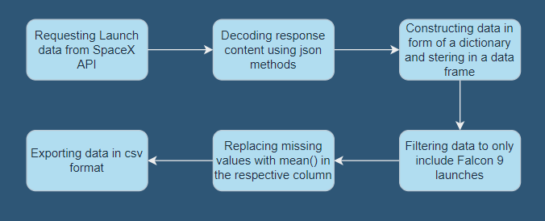
Data Collection – SpaceX API
GitHub URL: https://github.com/Harsha200321/IBM-Data-Science-Capstone-Project/blob/main/SpaceX_data_collection_API.ipynb

Slide 10
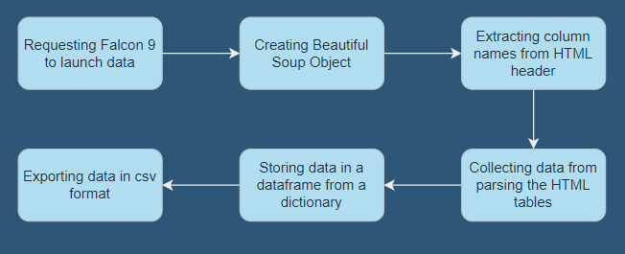
Data Collection - Scraping
GitHub URL: https://github.com/Harsha200321/IBM-Data-Science-Capstone-Project/blob/main/jupyter-labs-webscraping.ipynb

Slide 11

Data Wrangling
Performed exploratory data analysis and determined the training labels.
Calculated the number of launches at each site, and the number and occurrence of each orbits
We created landing outcome label from outcome column and exported the results to csv.
GitHub URL: https://github.com/Harsha200321/IBM-Data-Science-Capstone-Project/blob/main/Data_Wrangling.ipynb

Slide 12
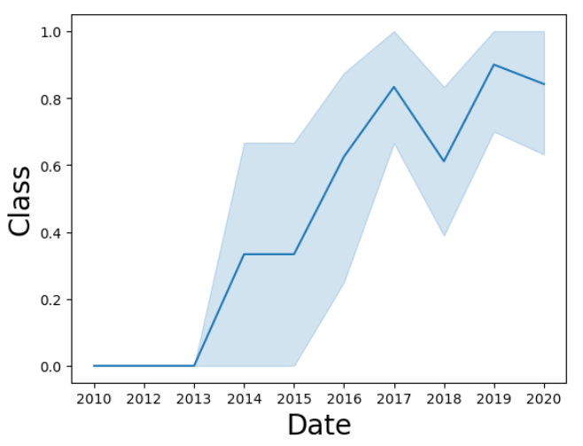
.
EDA with Data Visualization
We explored the data by visualizing the relationship between flight number and launch Site, payload and launch site, success rate of each orbit type, flight number and orbit type, the launch success yearly trend.
plot a line chart with x axis to be Year and y axis to be average success rate, to get the average launch success trend
GitHub URL: https://github.com/Harsha200321/IBM-Data-Science-Capstone-Project/blob/main/eda_data_viz.ipynb

Slide 13
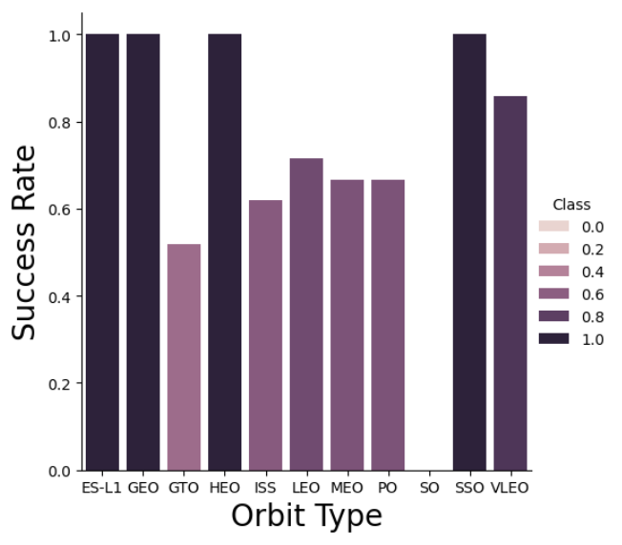
EDA with Data Visualization
We explored the data by visualizing the relationship between flight number and launch Site, payload and launch site, success rate of each orbit type, flight number and orbit type, the launch success yearly trend.

Slide 14
EDA with SQL
We loaded the SpaceX dataset into a PostgreSQL database without leaving the jupyter notebook.
We applied EDA with SQL to get insight from the data. We wrote queries to find out for instance:
The names of unique launch sites in the space mission.
The total payload mass carried by boosters launched by NASA (CRS)
The average payload mass carried by booster version F9 v1.1
The total number of successful and failure mission outcomes
The failed landing outcomes in drone ship, their booster version and launch site names.
GitHub URL: https://github.com/Harsha200321/IBM-Data-Science-Capstone-Project/blob/main/EDA_sql.ipynb

Slide 15
Build an Interactive Map with Folium
We marked all launch sites, and added map objects such as markers, circles, lines to mark the success or failure of launches for each site on the folium map.
We assigned the feature launch outcomes (failure or success) to class 0 and 1.i.e., 0 for failure, and 1 for success.
Using the color-labeled marker clusters, we identified which launch sites have relatively high success rate.
We calculated the distances between a launch site to its proximities. We answered some question for instance:
Are launch sites near railways, highways and coastlines.
Do launch sites keep certain distance away from cities.
GitHub URL: https://github.com/Harsha200321/IBM-Data-Science-Capstone-Project/blob/main/DV0101EN-3-5-1-Generating-Maps-in-Python-py-v2.0.ipynb

Slide 16
Build a Dashboard with Plotly Dash
We built an interactive dashboard with Plotly dash
We plotted pie charts showing the total launches by a certain sites
We plotted scatter graph showing the relationship with Outcome and Payload Mass (Kg) for the different booster version.
GitHub URL: https://github.com/Harsha200321/IBM-Data-Science-Capstone-Project/blob/main/spaceX_dashboard_app.py

Slide 17
Predictive Analysis (Classification)
We loaded the data using numpy and pandas, transformed the data, split our data into training and testing.
We built different machine learning models and tune different hyperparameters using GridSearchCV.
We used accuracy as the metric for our model, improved the model using feature engineering and algorithm tuning.
We found the best performing classification model.
GitHub URL: https://github.com/Harsha200321/IBM-Data-Science-Capstone-Project/blob/main/SpaceX_Machine%20Learning%20Prediction.ipynb

Slide 18
Results
Exploratory data analysis results
Interactive analytics demo in screenshots
Predictive analysis results

Slide 19

Section 2

Slide 20
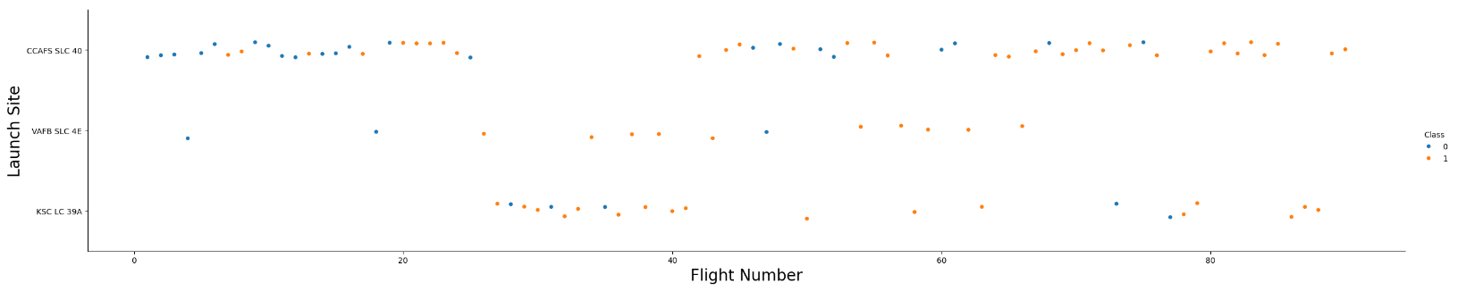
Flight Number vs. Launch Site
From the plot, we found that the larger the flight amount at a launch site, the greater the success rate at a launch site.

Slide 21
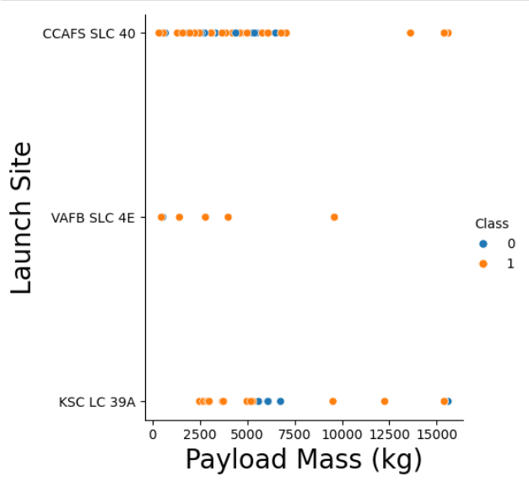
Payload vs. Launch Site
In the Payload Mass Vs. Launch Site scatter point chart the VAFB-SLC launch site there are no rockets launched for heavy payload mass(greater than 10000).

Slide 22
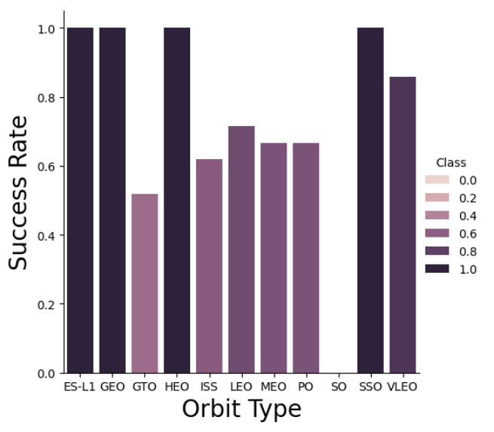
Success Rate vs. Orbit Type
The Orbit Types – ES-L1, GEO, HEO, SSO have the highest success rates as per the bar chart illustration

Slide 23
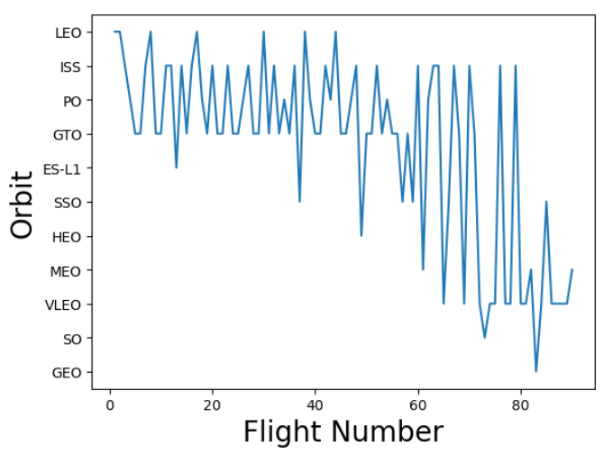
Flight Number vs. Orbit Type
You can observe that in the LEO orbit, success seems to be related to the number of flights. Conversely, in the GTO orbit, there appears to be no relationship between flight number and success.

Slide 24
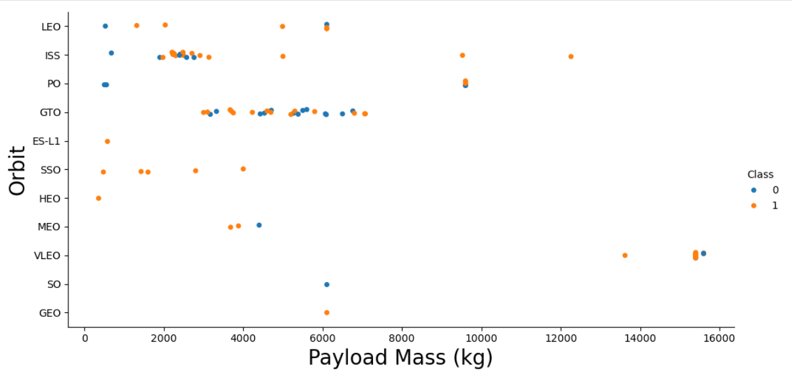
Payload vs. Orbit Type
With heavy payloads the successful landing or positive landing rate are more for Polar,LEO and ISS.
However, for GTO, it's difficult to distinguish between successful and unsuccessful landings as both outcomes are present.

Slide 25
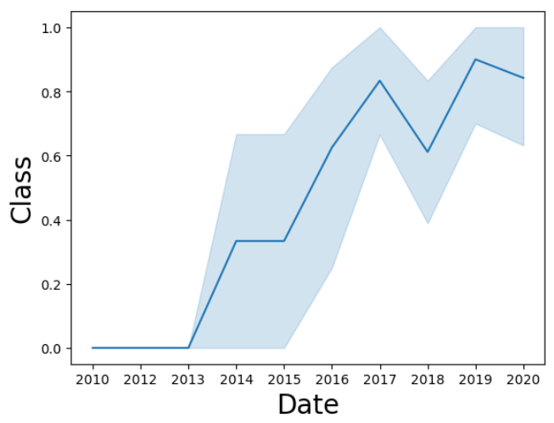
Launch Success Yearly Trend
The line chart shows the Yearly trend of launch success with date on X-axis and Class on Y-axis
The success rate since 2013 kept increasing till 2020

Slide 26
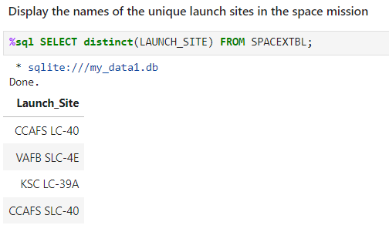
All Launch Site Names
There are 4 unique launch sites in the space mission namely – CCAFS LC-40, VAFB SLC-4E, KSC LC-39A, CCAFS SLC-40

Slide 27
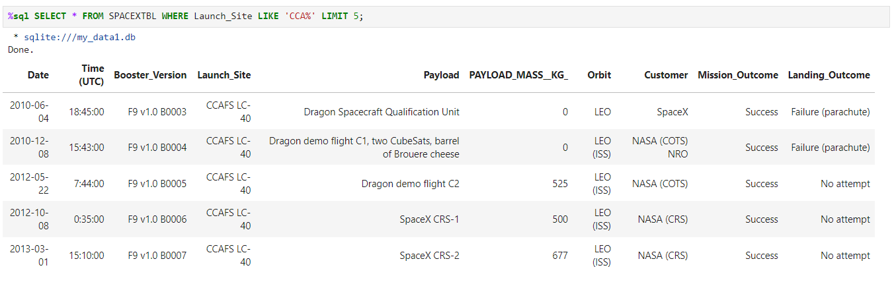
Launch Site Names Begin with 'CCA'
The 5 records where the launch sites being with string ‘CCA’ is shown below.

Slide 28
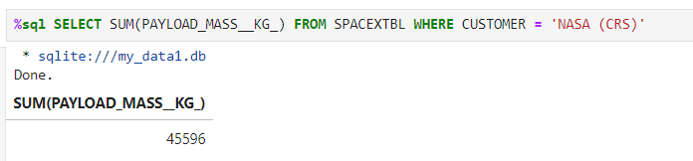
Total Payload Mass
Total Payload Mass carried by boosters launched by NASA is 45596 kg.

Slide 29
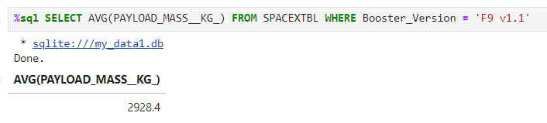
Average Payload Mass by F9 v1.1
Average Payload Mass carried by booster F9 v1.1 is 2928.4 kg.

Slide 30
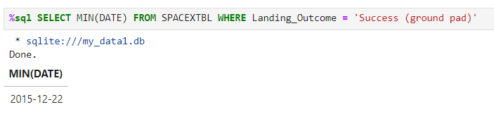
First Successful Ground Landing Date
The first successful ground landing date is 22nd December, 2015.

Slide 31
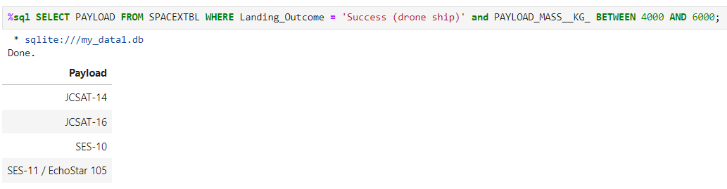
Successful Drone Ship Landing with Payload between 4000 and 6000
The list of names of boosters which have successfully landed on drone ship and had payload mass greater than 4000 but less than 6000 are:
JCSAT-14
JCSAT-16
SES-10
SES-11//EchoStar 105

Slide 32
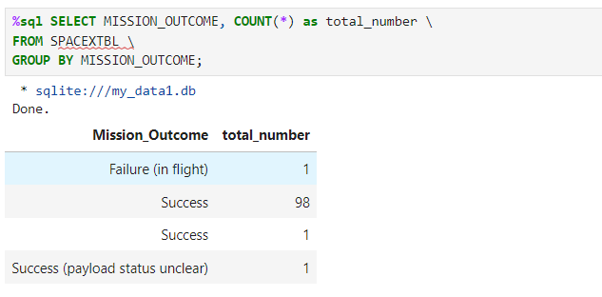
Total Number of Successful and Failure Mission Outcomes
Calculate the total number of successful and failure mission outcomes
Present your query result with a short explanation here

Slide 33
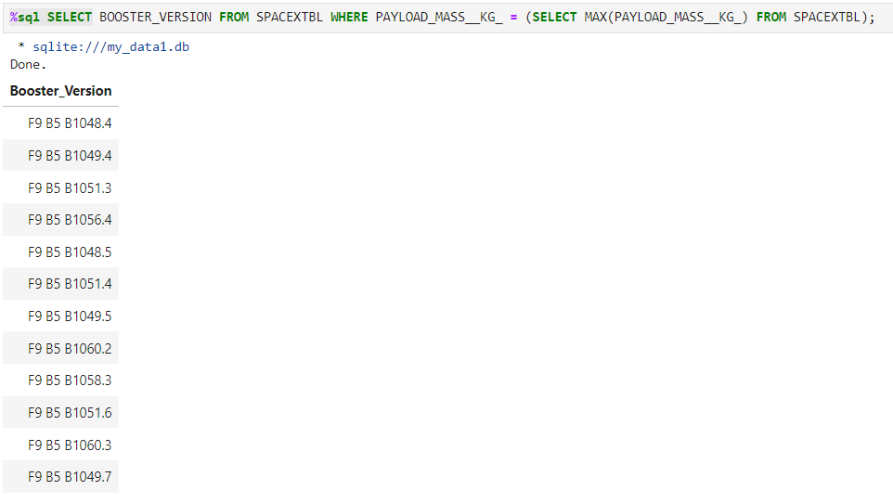
Boosters Carried Maximum Payload
The booster versions which carry the maximum payload is shown in the image beside.

Slide 34
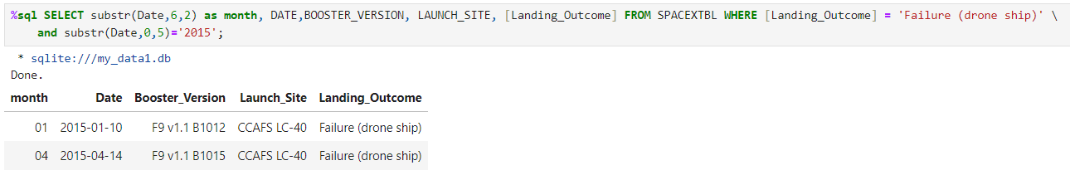
2015 Launch Records
The list of Launch Records in 2015 for Failure of landing outcome for drone ship has been displayed below

Slide 35
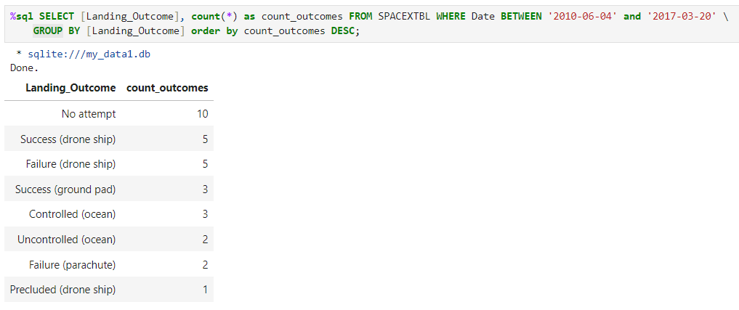
Rank Landing Outcomes Between 2010-06-04 and 2017-03-20
From the result of the rand landing outcomes between 2010-06-04 and 2017-03-20, we can say that most of the time there were no attempts for Landing outcome.

Slide 36

Section 3

Slide 37

All Launch sites on global map

Slide 38
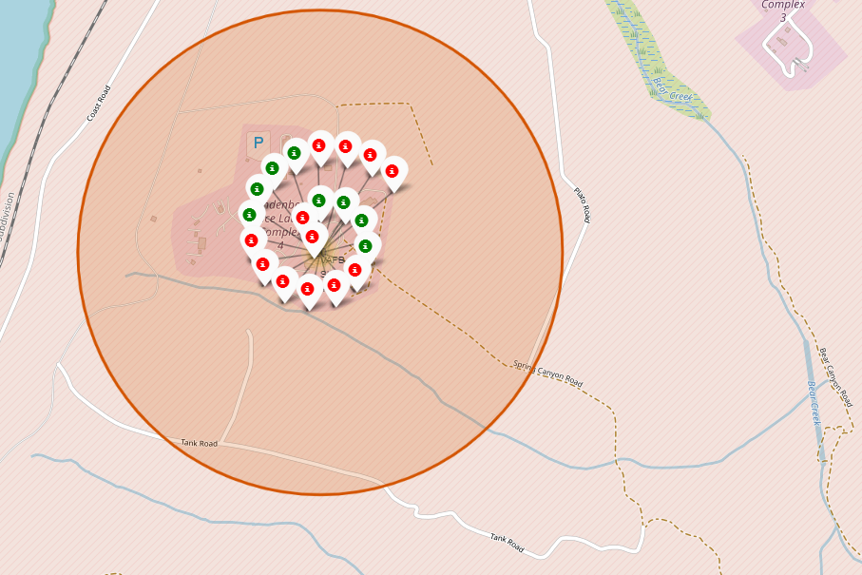
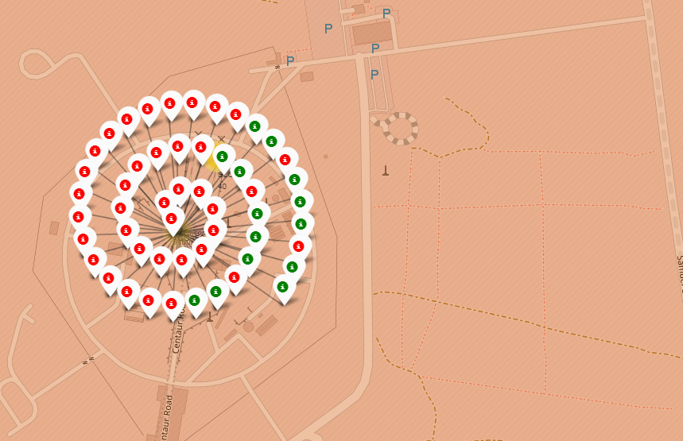
Markers with Launch Sites in color labels

Slide 39
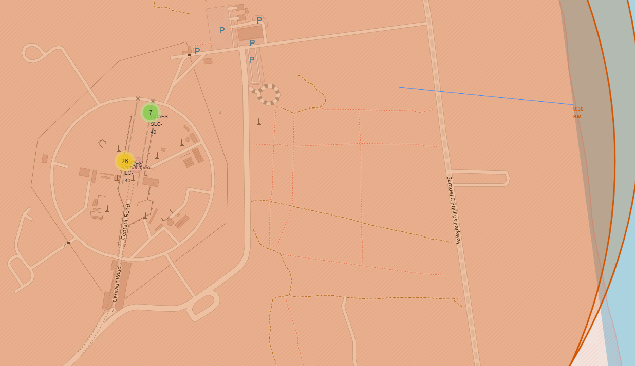
Launch Site Distance to the Landmarks

Slide 40

Section 4

Slide 41
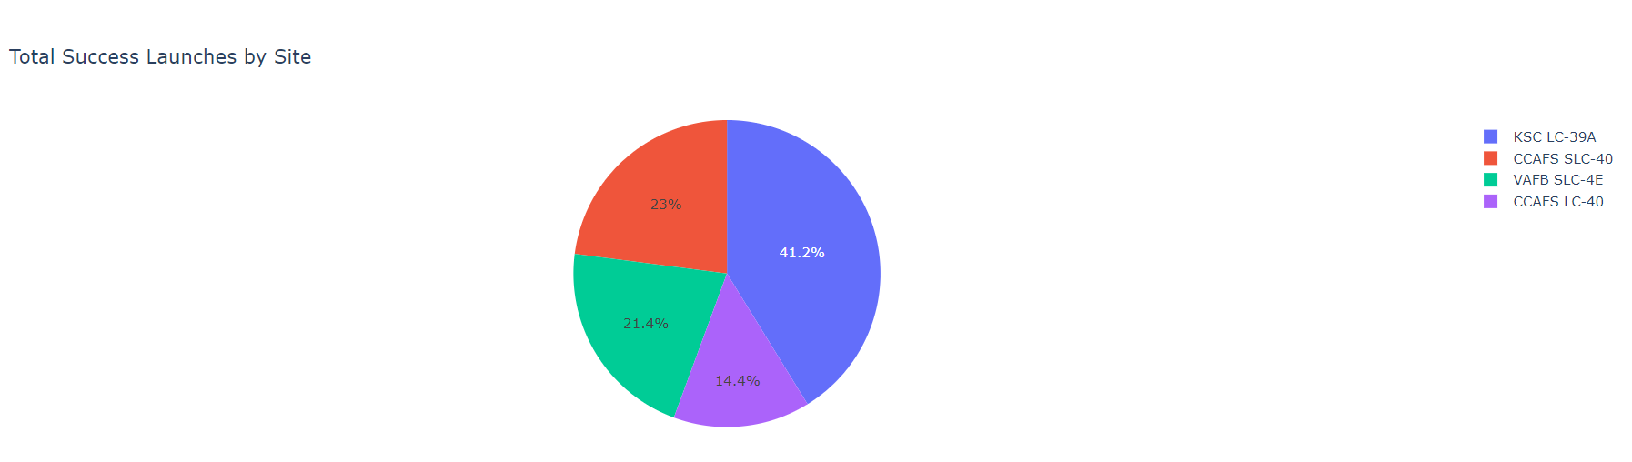
A Pie Chart illustrating the percentage of successful launches of different launch sites
KSC LC-39A has the most successful Launches from all the launch sites

Slide 42
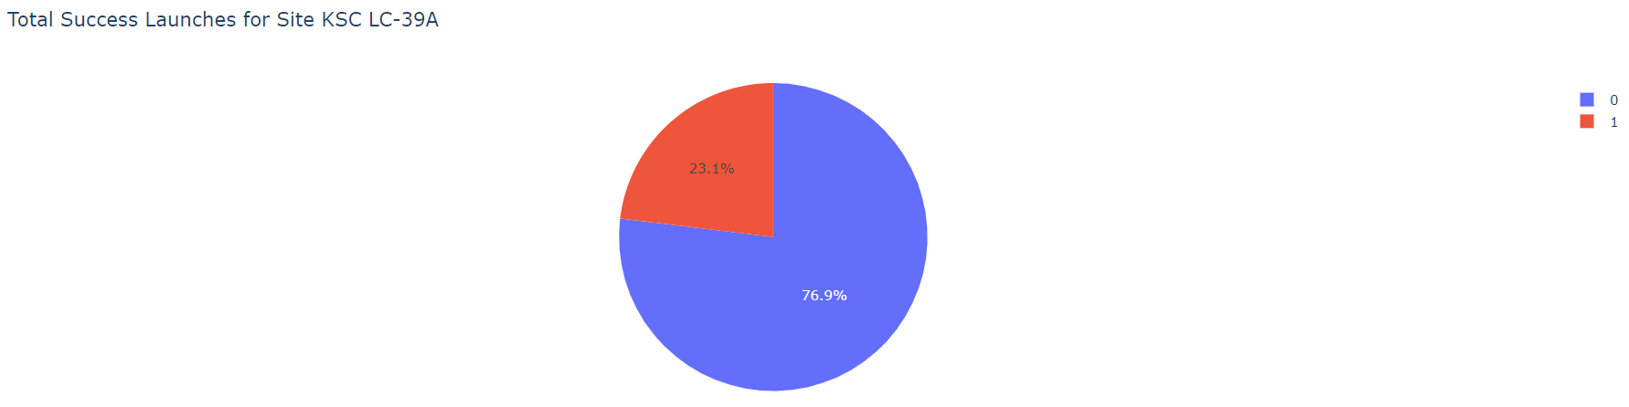
Pie chart showing the ratio of launch success for the top launch success site
More than three fourths of the launches for the site KSC LC-39A were successful

Slide 43
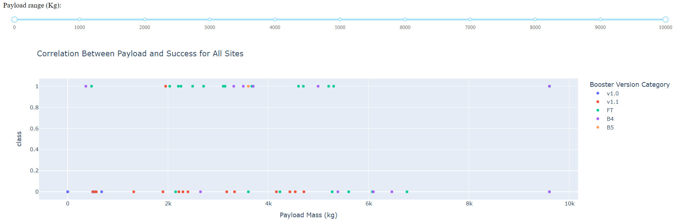
Relation between the Payload and the Success for all the sites from 0 to 10000 range
The B4 booster version has the highest payload mass, close to 10000 kg

Slide 44

Section 5

Slide 45
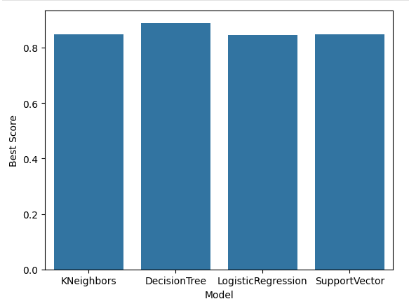
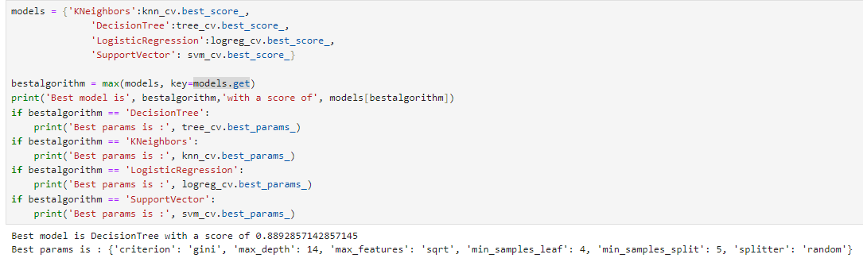
Classification Accuracy
The decision tree classifier has given the best score of 89% accuracy.

Slide 46
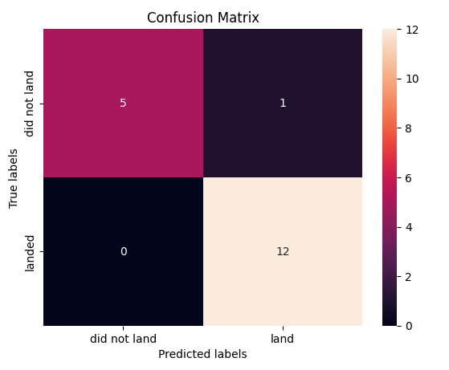
Confusion Matrix
The confusion matrix for the decision tree classifier shows that the classifier can distinguish between the different classes.
The main problem is the false positives .i.e., unsuccessful landing predicted as successful landing by the classifier.

Slide 47
Conclusions
We can conclude that:
A higher number of flights from a launch site correlates with a greater success rate at that location.
The success rate of launches began to rise significantly from 2013 through 2020.
Orbits like ES-L1, GEO, HEO, SSO, and VLEO achieved the highest success rates.
KSC LC-39A recorded the most successful launches among all sites.
The Decision Tree classifier proved to be the most effective machine learning algorithm for this task.

Slide 48


